Slide 1
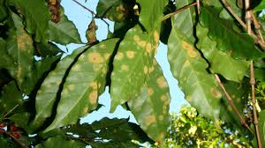
RUST ON COFFEE PLANTS, A PARASITE TO BE ELIMINATED WITH DECISION TREES
Daniel Alejandro Cifuentes Londoño
Cristian Alexis Giraldo Agudelo
Medellín, October 29

Slide 2
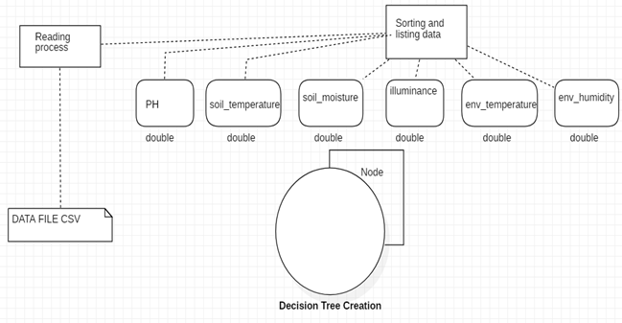
Data Structures Designed
Graph 2: Saved the CSV document in the linkedList

Slide 3
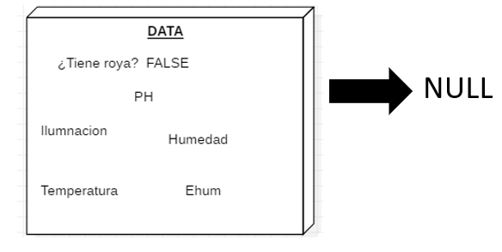
LinkedList

Slide 4
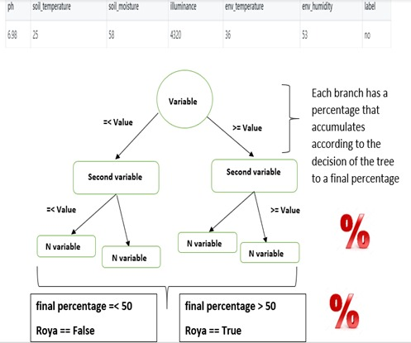
Data Structures Designed
Graph 1: This operation determines the value of the first variable. Depending on the value, it stores a percentage in an external variable.

Slide 5
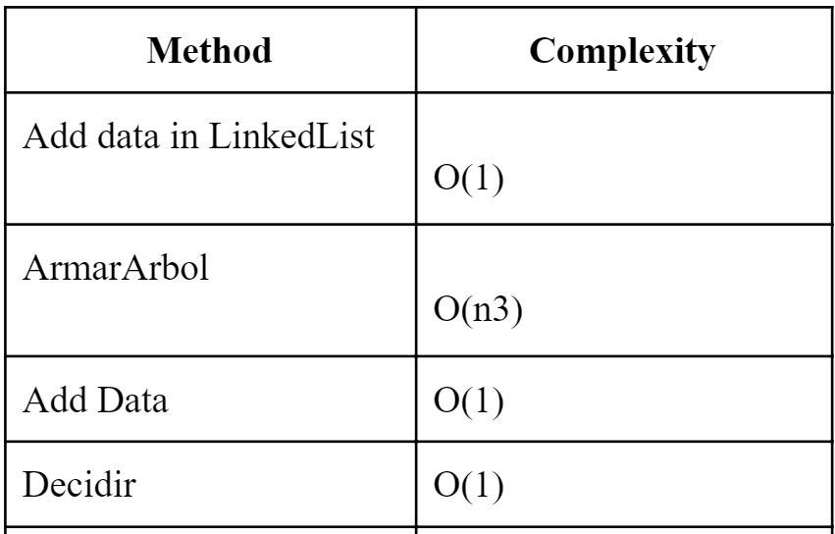
Data Structure Operations
Table 1: Complexity of the operations performed by the data structure

Slide 6
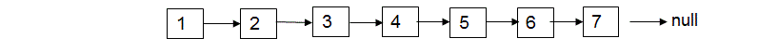
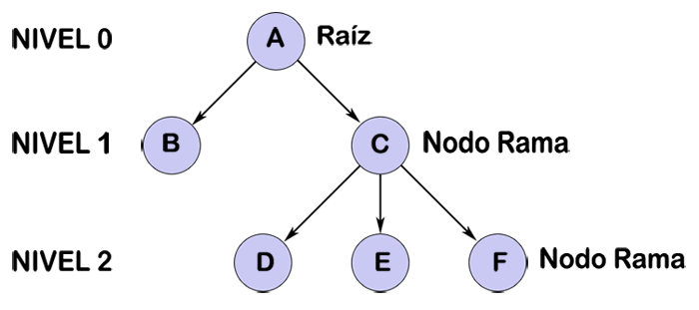
N. It is the number of data
N. It is the number of node

Slide 7
Design Criteria of the Data Structure
The structure of trees, are effective to sort and search data with less complexity of Big-O.
The structure created adapts to possible modifications by other engineers
Memory consumption is particularly low, so its transitivity and data management is highly competent

Slide 8
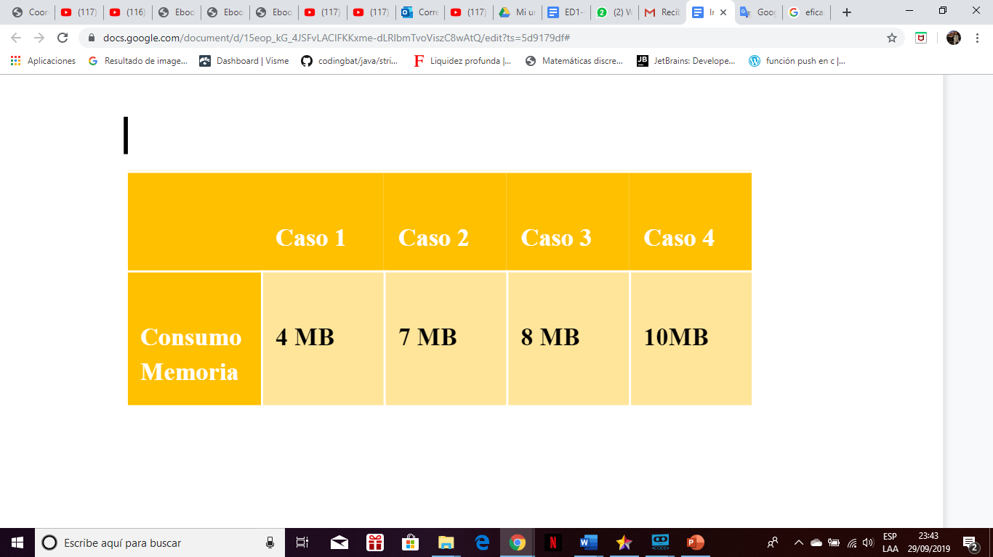
Memory Consumption

Slide 9
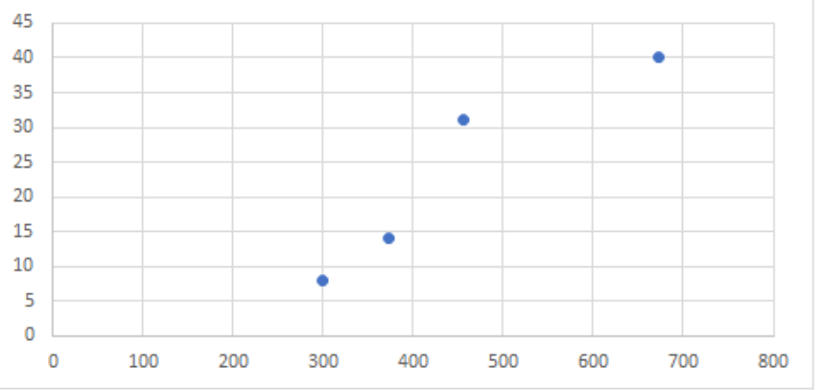
Time Consumption

Slide 10
REFERENCES
[1] Bsea, Dankz, Farisori, Jesuja, LordT, Paintman, Pinar, Superzerocool, Tano4595, Varano. ~ Algoritmo ID3 ~ . 2014. Retrieved August 11 2019. From https://bit.ly/2MV9exD
[2] Espino, Tijerina, Cedano, de la Fuente , Pérez, Chiñas. ~ ALGORITMO C4.5 ~ . November 2005. Retrieved August 11 2019. From http://bit.ly/2yTgnq2
[3] IBM. ~ NODO C5.0 ~ . . Retrieved August 11 2019. From https://ibm.co/2Z3Kaak
[4] Amir Ali. ~ Decision Tree (CART) Algorithm in Machine Learning ~ . July 2018. Retrieved August 11 2019. From https://bit.ly/2ZWCOGO

